Slide 1


CS410 Project on Brand’s Sentiment Analysis
Team AEJ:
Ayush Khanna (akhanna6) – Team Lead
Ethan Alberto (ethanma3)
Jayanth Chandra (jc101)

Slide 2
Introduction

Slide 3
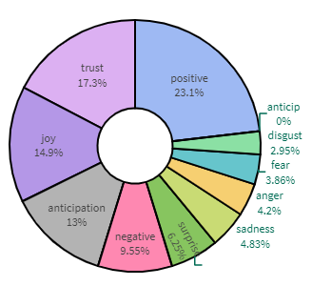
Brand’s Sentiment Analysis using Tweets
Capture Customer Feedback on FMCG Brands
Perform Sentiment Analysis
Polarity Analysis
Emotion Analysis
Trending Topics using Okapi BM25
Time Series Feedback
Tweets by Sentiment
Net Promotor Score (NPS)
Geographic Location tagging on Sentiments

Slide 4
Installation Instructions

Slide 5
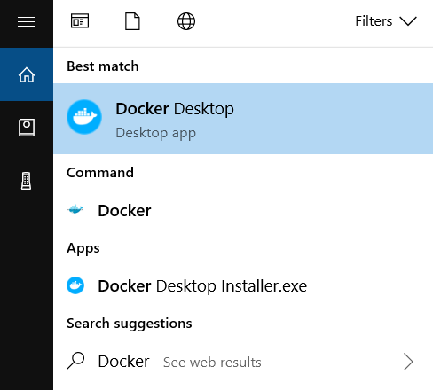
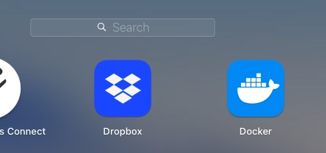
Installation Instructions – Docker Image
Please install Docker in your machine:
Use below link if you are running the software on Windows:
Install on Windows | Docker Documentation
Use below link for Mac installation:
Install on Mac | Docker Documentation
Once installed, start the Docker Engine in your machine.

Slide 6
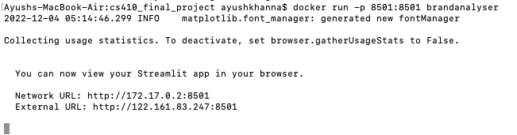
Installation Instructions – Git Clone and Run
Clone the github Repository from Command line or Terminal:
git clone https://github.com/akhanna6/CS410-CourseProject-Team-AEJ.git
Go inside CS410-CourseProject-Team-AEJ directory.
cd CS410-CourseProject-Team-AEJ
Build the Docker Image (make a note of . (dot) at the end) – Approx. time to run 2 mins
docker build -t brandanalyser .
Run the Docker Container
docker run -p 8501:8501 brandanalyser

Slide 7
Explore the Software

Slide 8
Software Components - Libraries
There are several NLP and Text Retrieval Libraries used.
snscrape Library – Scrape N Tweets for the given Time Period.
NLTK – Python Library that provide tools for Natural Language Processing. e.g,. nltk.stem.wordnet, nltk.corpus
Streamlit – Python framework to build the Dashboard / Web Application.
nrclex – Emotion Analysis
Google’s geopy – Geographic location of tweets based on Sentiments.
rank_bm25 – Okapi BM25 retrieval model to find Top 3/N trending Topics.
Others – numpy, plotly, matplotlib, pandas, wordcloud, etc.
User must run the software using the Docker Image provided.

Slide 9
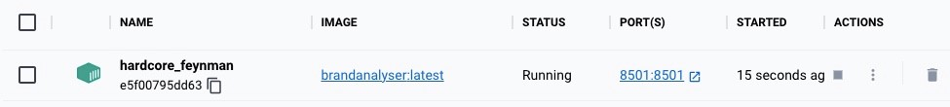
How to Run the Software
Must run it using the Docker image provided. Follow the instructions given in Installation Section.
Ensure that you see snapshot like below in your Docker
To use the software, open the URL which you see once you type docker run -p 8501:8501 brandanalyser in your command line.
Alternatively, you can also open it by clicking on URL visible inside PORT(S) in Docker Image.

Slide 10
Use Case

Slide 11

What is the Use Case?
“Reebok recently launched a new product in the market. Mr. A is the Brand Development Manager at Reebok. Recently, he has given a task to find out the Customer sentiments on Reebok products over the past week. Using customer sentiments, the company plans to improve its marketing and advertisement strategy to increase product sales. Mr. A feels that he can send the survey questions to his customers to get feedback, but he also knows that not all customers respond to such surveys. So, he must find a better way to obtain customer sentiments. How will you help Mr. A in his task?”

Slide 12

Use Case = Perform Sentiment Analysis
Looking at the use case, Mr. A wants to get insights on the following areas:
Get Reebok’s Customer Sentiments over the past week.
Identify the Trending Topics in Customer feedback.
How is Reebok’s reputation amongst customers, by measuring the NPS score?
Identify the Top trending discussions in tweets.
Mr. A can get all this information using the tool built by us by analyzing the user’s tweets on Reebok over a week.
Our Software is capable to provide deeper sentiments (emotions) and even provides geographic locations to help in deciding the brand’s strategy.

Slide 13
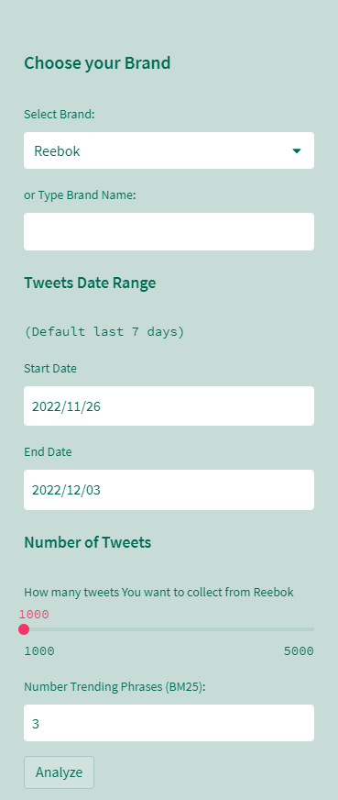
Part 1: Provide Details
Run the software using the instructions (docker) given in earlier section and provide the following details:
Mr. A chooses “Reebok” as Brand.
Keep the default Date Range (Last 7 days).
Number of Tweets to 1000.
Mr. A wants to find the top 3 trending topics.
Mr. A then run the Software by clicking on ‘Analyze’.

Slide 14

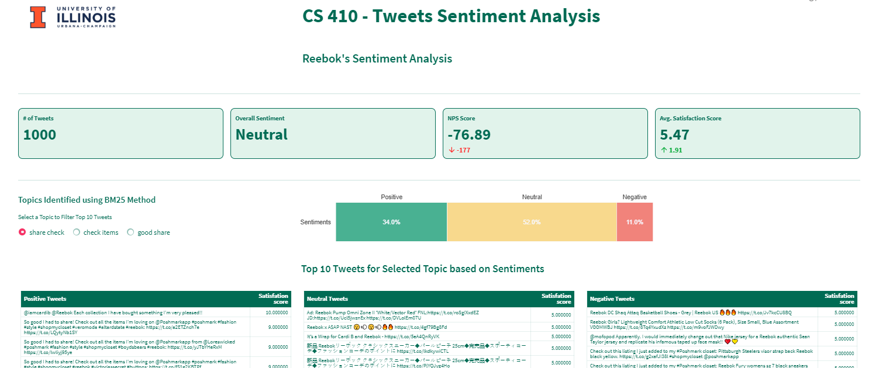
Part 2: Analyze the Results
Mr. A finds that the results are available within a few minutes of wait. Software scraped the thousands of tweets using snscrape, performed the Text retrieval and analysis techniques and gave the final results.

Slide 15
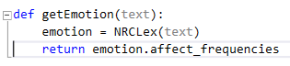
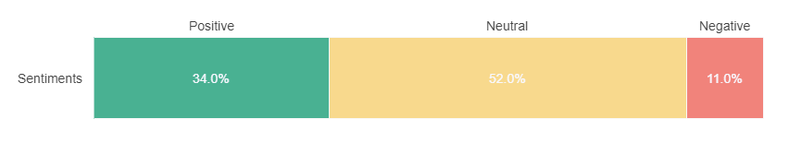
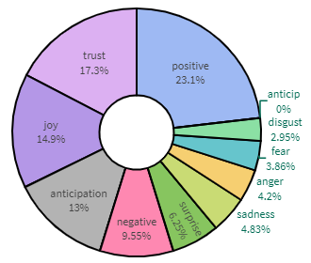
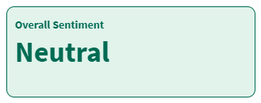
Part 2a: Polarity and Emotion Analysis
Polarity Analysis:
Extract sentiments from tweets using TextBlob Library (Positive, Negative and Neutral).
Polarity range is from -1.0 to +1.0
Negative : Polarity < 1
Neutral: Polarity = 0
Positive: Polarity > 1
Helps in finding the overall sentiment for a Brand.
Emotion Analysis:
Our Software also helps identify emotions beyond polarity using NRCLex library

Slide 16
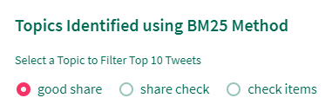
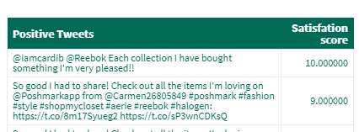
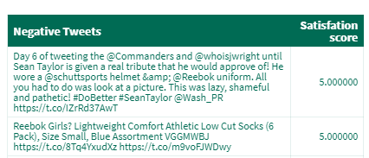
Part 2b: Trending Topics and Satisfaction Score
Top 3 Trending Topics
Using Okapi BM25 (BM25Okapi), our software identifies the trending topics and provides Top 10 tweets on each sentiment category (positive, negative and neutral). During this process we also remove Stop words.
Software also calculates the Customer Satisfaction score between 1 (lowest) and 10 (highest) for each feedback/tweet.
Score = ( Polarity + 1 ) / 2 * 10

Slide 17
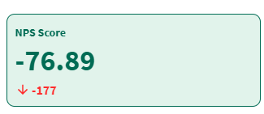
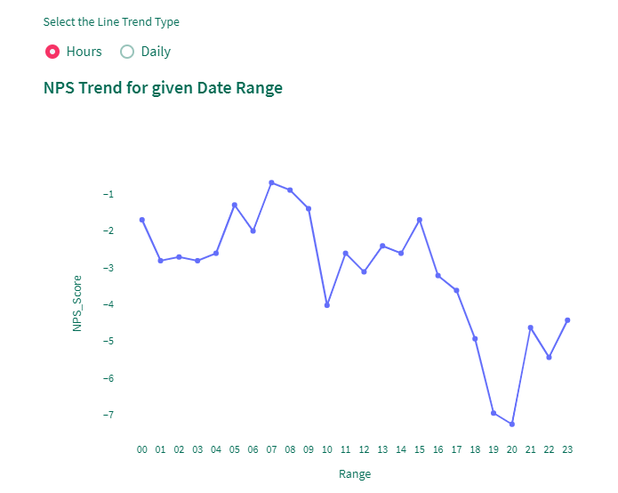
Part 2c: Net Promotor Score (NPS) and it’s Trend
NPS is a Customer loyalty metric that companies uses to know how likely customers would recommend their brand to others.
NPS = (Promotors – Detractors)/Total Reviews
Promotors = Loyal customers who will keep buying the and referring others (Satisfaction Score >=8)
Detractors = Unhappy customers who can hurt your brand through negative word-of-mouth (Satisfaction Score 0 -6).

Slide 18
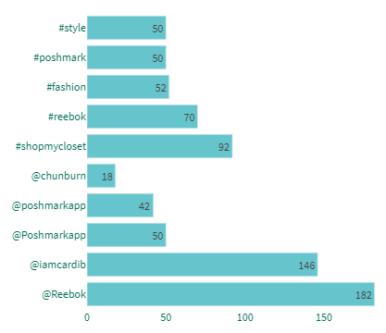
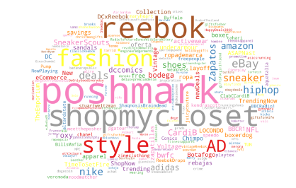
Part 2d: Top Trending Discussions
Our Software also finds the top 5 trending Topics from #hashtags and @mentions to help Mr. A know Brand’s trending topics in discussion.
The number of @mentions and #hashtags decide the popularity of a topic.
Our tool also gives a Word Cloud (WordCloud) showing all topics identified in customer tweets.

Slide 19
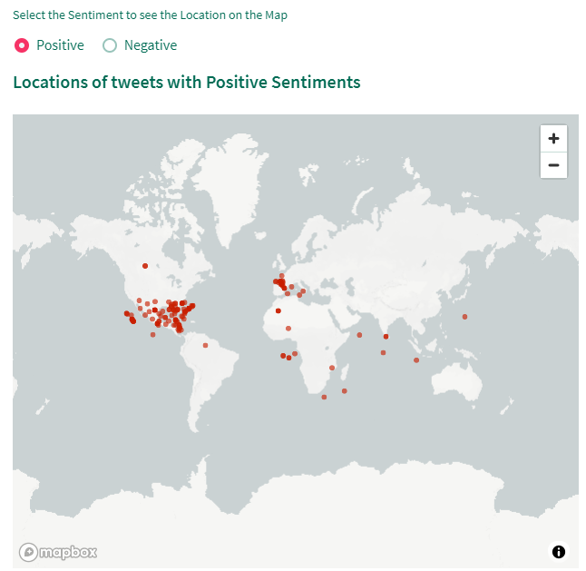
Part 2e: Geographic Locations by Sentiment
Mr. A can now also know on which locations (geolocator.geopy) Customer’s are not happy and on which all locations customers are happy.
This is a crucial result which helps the company to know where they must revise the brand strategy to improve the Product sales.

Slide 20
Future Scope

Slide 21
Project Future Scope
There are some areas which can be worked on in Future:
The Performance of the Web Application is directly dependent on the number of Tweets selected and on the selected date range.
We have seen that the application takes time if we increase the date range to more than a month with tweets greater than 5000. For the project demo purpose, we recommend running the application with 1000 tweets and a default date range of 7 days.
We can improve this performance in future.
Google’s geopy library Limitations:
geopy is a free API. That’s why it can run once per sec for the given location to obtain map coordinates. Due to this reason, the map to show sentiments takes a long time (approx. 6-7 mins). We can improve this performance in future by using Google’s paid subscription APIs.
We sometimes see timeout errors while running the geopy library. This timeout can be handled in future enhancements.
Provide Brand comparison: We can even expand the project to showcase the Brand results against its competitors.

Slide 22
Thank You

